Slide 1

WAY TO ENTERPRISE
Pakage 1: Database

Slide 2
WAY TO ENTERPRISE
Lesson 1

Slide 3

Agenda
Web architecture
Comparing Excel & Database
Database Components
SQL Statement
Create Example Table
Copyright © VTI Academy All Rights Reserved

Slide 4

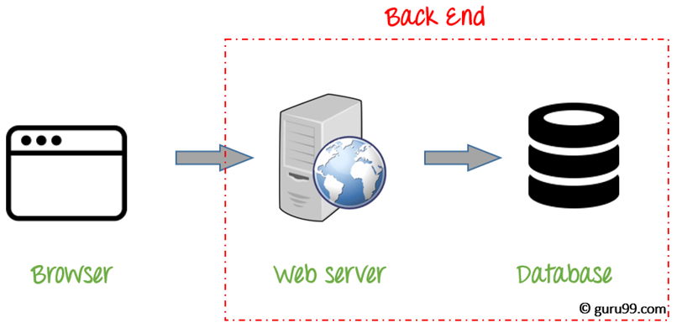
Web architecture

Slide 5
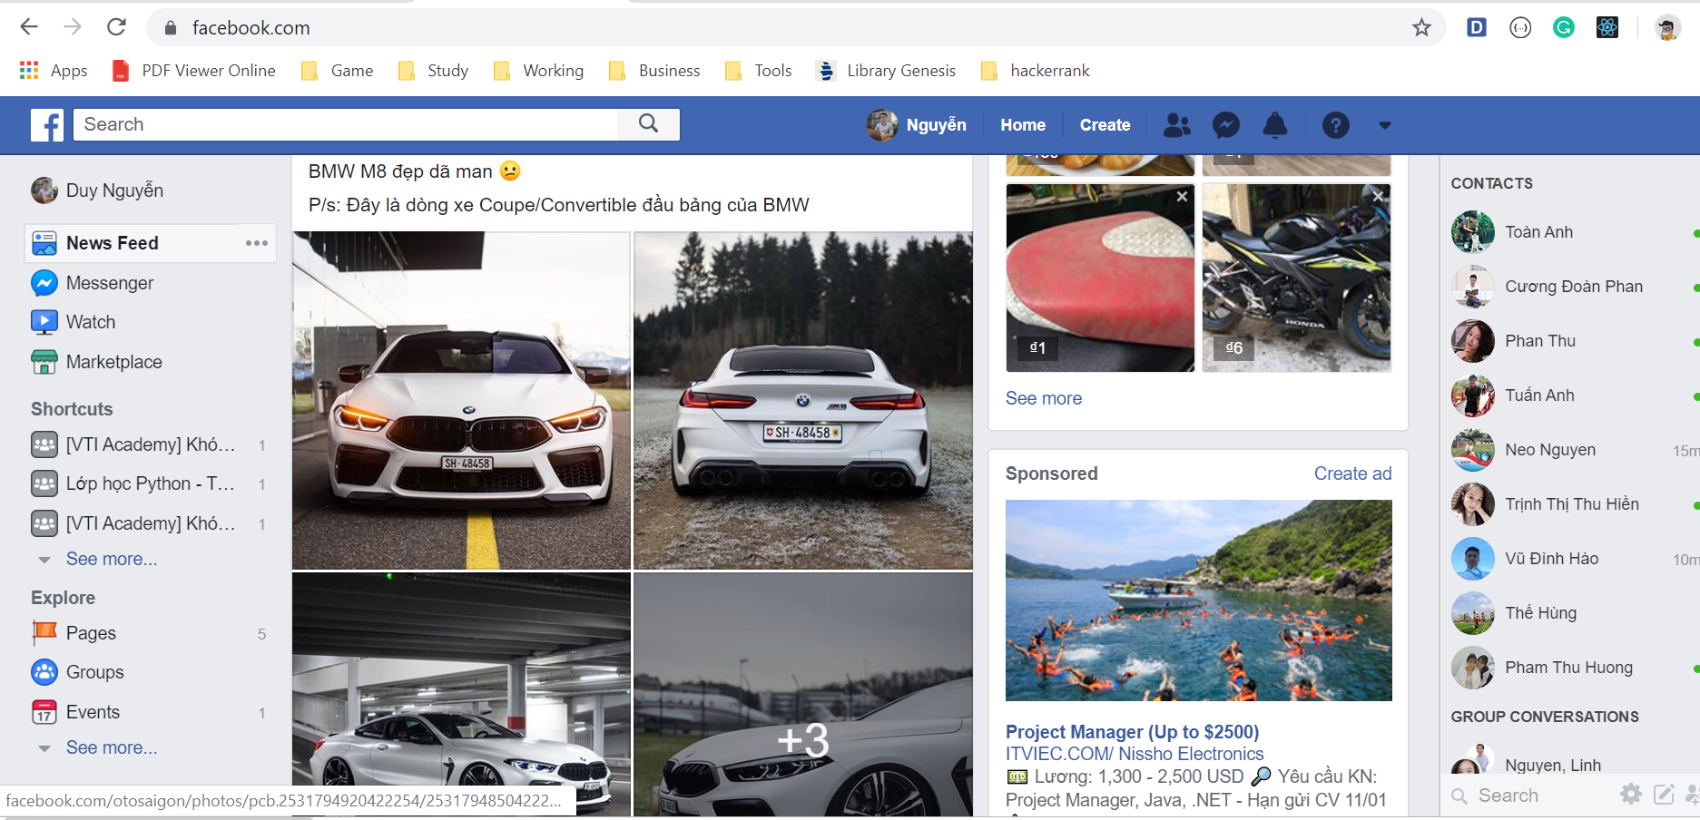
Web architecture
Front-end

Slide 6

Web architecture
Front-end

Slide 7

Web architecture
Backend

Slide 8

Web architecture
Database

Slide 9

Excel & Database

Slide 10
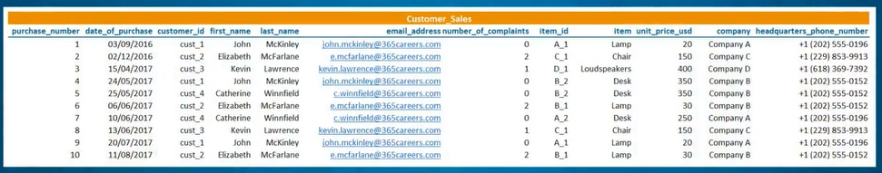
Excel

Slide 11
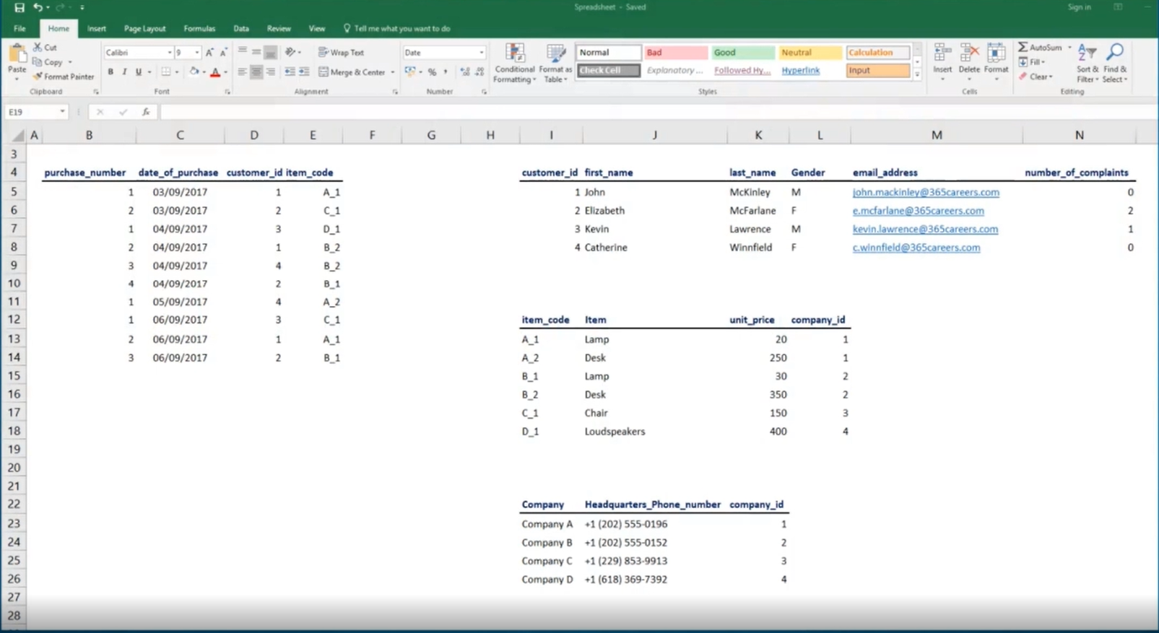
Excel

Slide 12
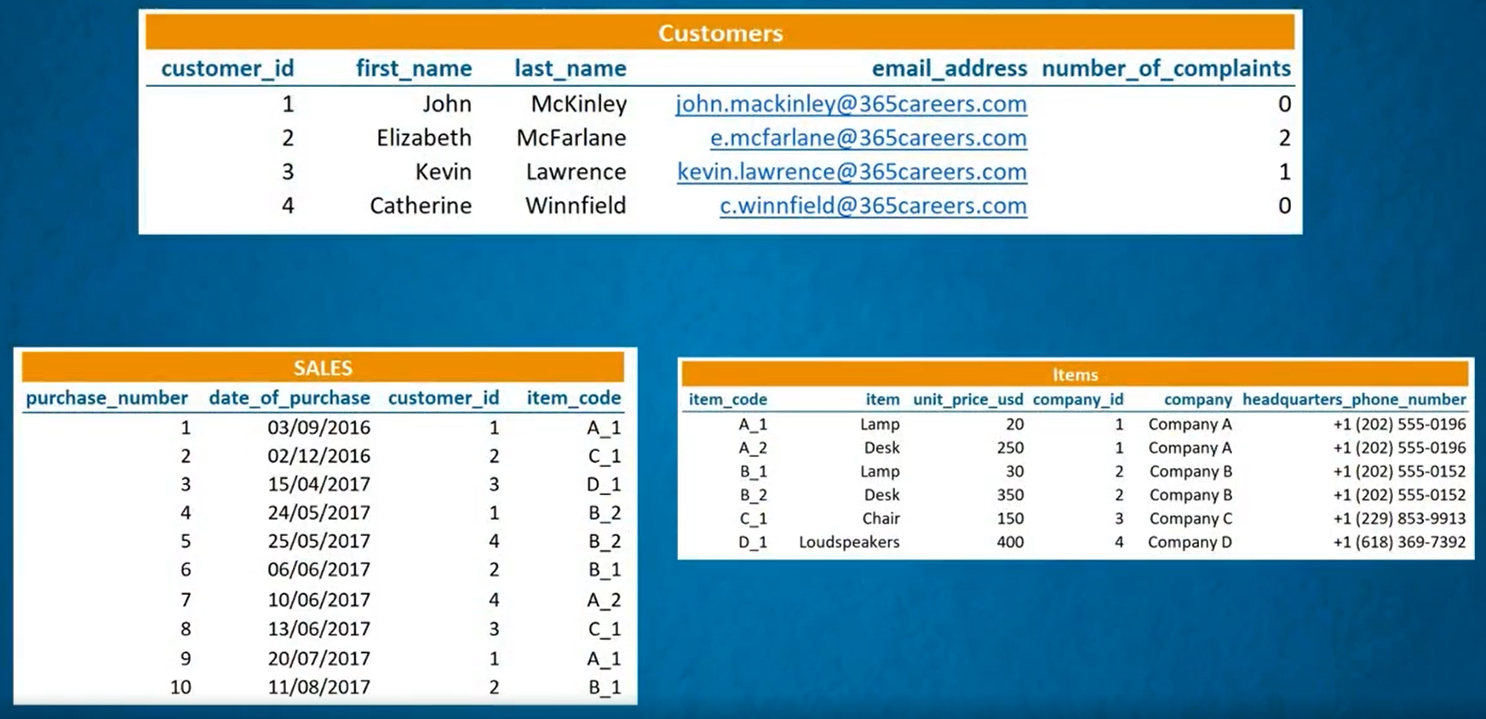
Database

Slide 13

Database components

Slide 14

Database Management System

Slide 15

Database

Slide 16
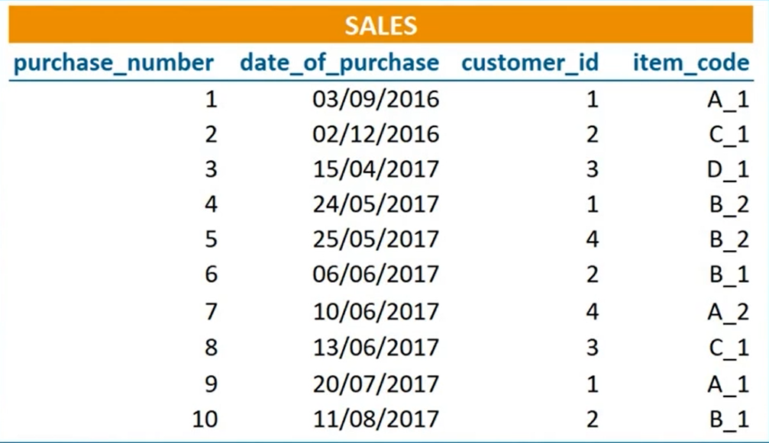
Table

Slide 17
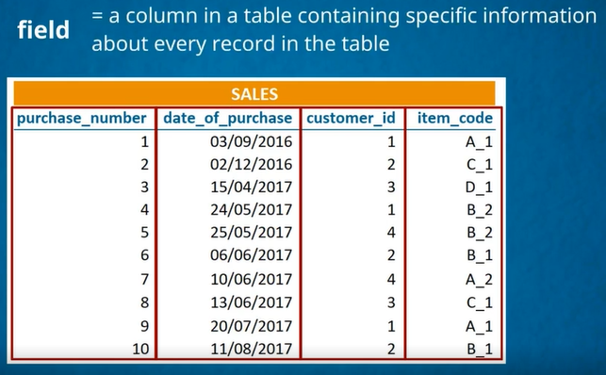
Column (Field)

Slide 18
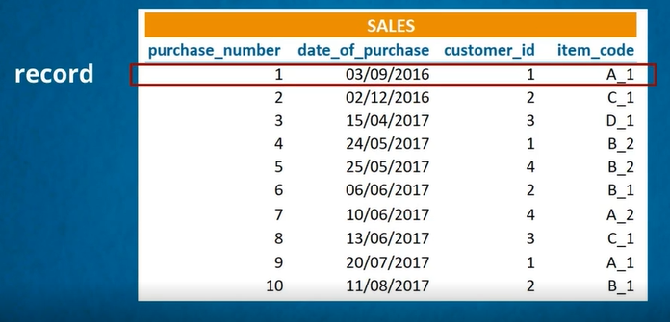
Record (row)

Slide 19

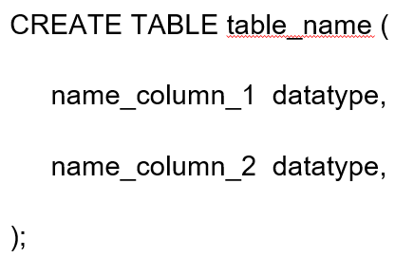
SQL Statement
Create Database
Create table

Slide 20
Datatype
Number: INT
Characters: VARCHAR(50)
Date: DATE

Slide 21
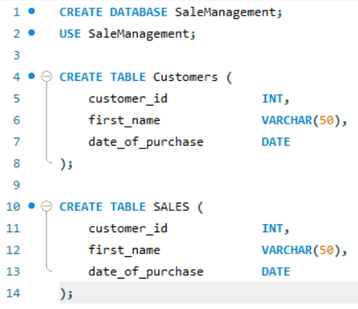
Create Example Table

Slide 22
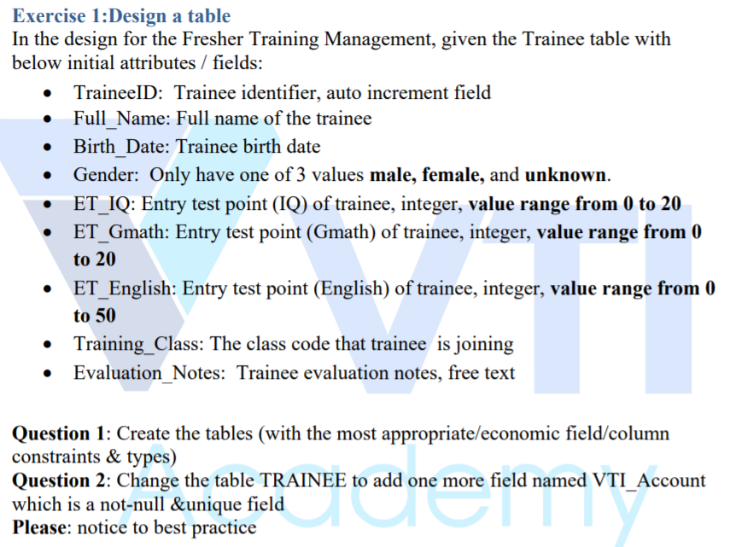
Assignments 1

Slide 23
Assignments 2
Assignment for Testing System

